Slide 1



A Review of 1076 - 2002 IEEE Standard for VHDL
by Furkan Kaya, Koray Karakurt, Mert Ecevit, Orhan Çalışkan, Seyit Koçak and Talha Telli
19/11/2024

Slide 2
1. Design entities & configurations
Chapter 1 and 2
Presenter:
Mert Ecevit
1.1 Entity Declarations
1.2 Architecture Bodies
1.3 Configuration Declarations
2. Subprograms and packages
2.1 Subprogram Declarations
2.2 Subprogram Bodies
2.3 Subprogram Overloading
2.4 Resolution Functions
2.5 Package Declarations
2.6 Package Bodies
2.7 Conformance Rules

Slide 3
1.1 ENTITY DECLARATIONS
Design entity: The main hardware abstraction, which is a collection of interconnected components
Entity declaration: Defines the interface between a design entity and its environment
Ports and generics: Ports provide the input/output connections, while generics offer adjustable constants for the design
1.2 ARCHITECTURE BODIES
Architecture body: Describes the internal operation of a module
Architecture body description: Defines the internal structure, behavior, or dataflow of the design
Architecture components: Can include declarations and concurrent statements
Multiple architectures: Can exist for a single entity, each representing a different implementation with the same interface

Slide 4
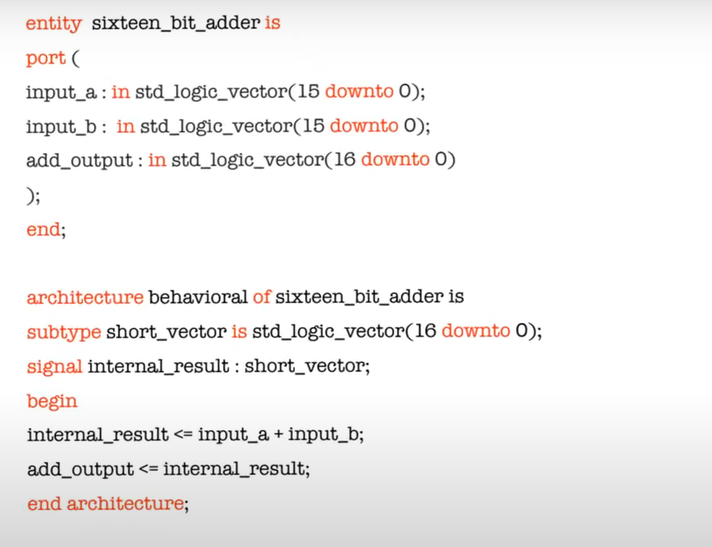
ENTITY AND ARCHITECTURE EXAMPLE
Abbas, K. (2020). Handbook of Digital CMOS Technology, Circuits, and Systems. In Springer eBooks. https://doi.org/10.1007/978-3-030-37195-1

Slide 5
7.3 Configuration Declarations
Configuration specification: Associates component instances to design entities such as blocks and components
Block Configuration: Indicates how components and their configurations are bound and scoped, and how internal and external blocks are organized and connected inside a design
Component Configuration: Describes how component instances within a block are configured, including their bindings to design entities and any related block configurations, ensuring consistent bindings across instances

Slide 6
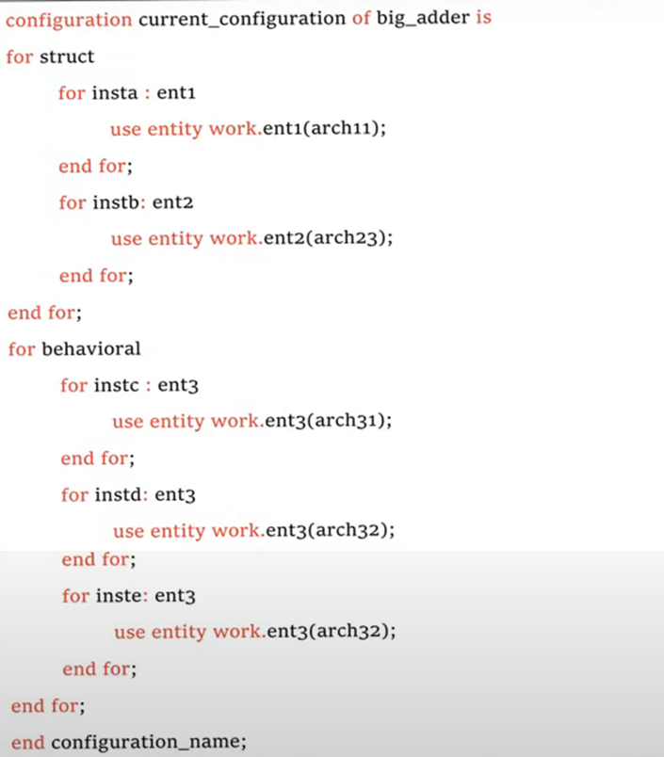
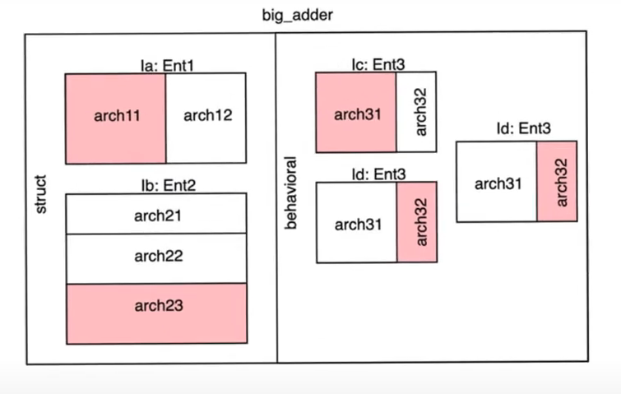
CONFIGURATION EXAMPLE
Abbas, K. (2020). Handbook of Digital CMOS Technology, Circuits, and Systems. In Springer eBooks. https://doi.org/10.1007/978-3-030-37195-1

Slide 7
2.1 Subprogram Declarations
Subprograms: Algorithms that define computation or behavior, used for value conversion, signal resolution, or process portions
Procedure: A subprogram that performs an action but does not return a value
Function: A subprogram that computes and returns a value
Formal Parameters: Variables in a subprogram declaration that represent the data passed into the subprogram when called
Constant and Variable Parameters: Each subprogram call has its own access privileges, with only constant or variable parameters passed in or out.
Signal Parameter: References to the signal and its driver are passed into the subprogram for a formal parameter of class signal.

Slide 8
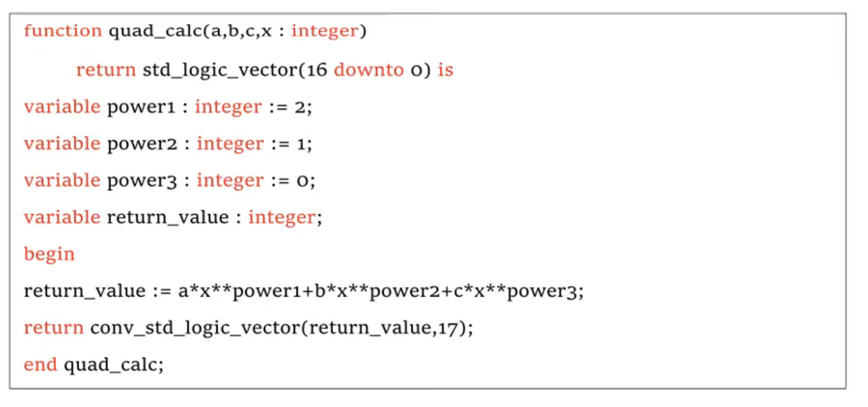
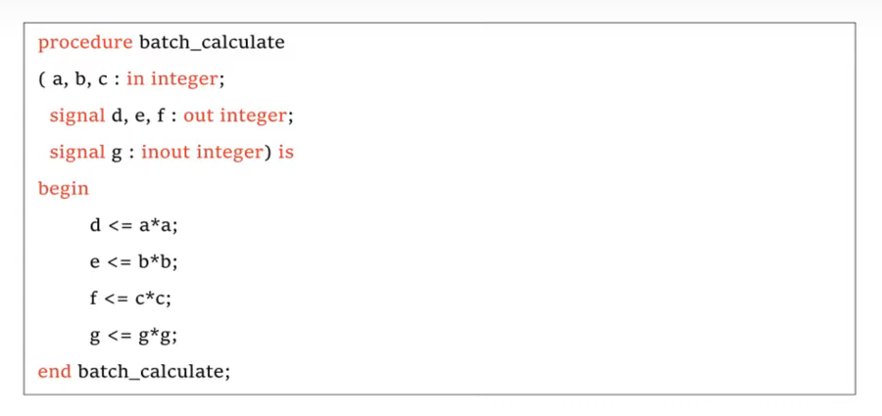
2.2 Subprogram BODIES
File Parameters: The subprogram receives references to the file, with matching external associations and access modes for formal and actual parameters, and limited type conversions.
Abbas, K. (2020). Handbook of Digital CMOS Technology, Circuits, and Systems. In Springer eBooks. https://doi.org/10.1007/978-3-030-37195-1

Slide 9
2.3 Subprogram Overloading
Subprogram Overloading: Occurs when subprograms share a name but differ in parameter or result types, ambiguity arises if the parameters don’t uniquely identify one subprogram
Operator Overloading: Allows functions to overload operators, with unary operators taking one parameter and binary operators taking two
Signatures: Define the unique match for overloaded subprograms or enumeration literals based on parameter count and types
Resolution Functions: Combines signal sources into a single value, they are linked to the signal or its subtype via their declaration
Invocation of the Resolution Function: For active resolved signals, this function is automatically called during each simulation cycle to determine the signal's value, ignoring "off" drivers
2.4 RESOLUTION FUNCTIONS

Slide 10
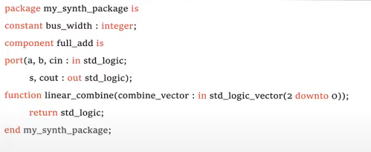
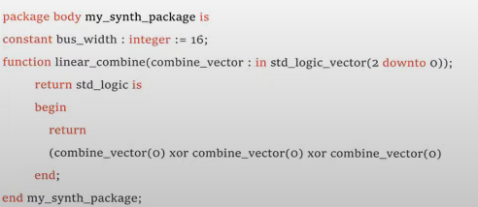
2.5,6,7 PACKAGES AND CONFORMANCE RULES
Package Declaration: Defines visible elements like types and subprograms, and can expand scope to other units.
Package Body: Contains hidden details like subprogram bodies and constants; it repeats the package identification and hides internal components.
Conformance Rules: Subprograms with matching lexical elements are conformant, allowing variations like extended names or similar literals as long as the meaning stays consistent.
Abbas, K. (2020). Handbook of Digital CMOS Technology, Circuits, and Systems. In Springer eBooks. https://doi.org/10.1007/978-3-030-37195-1

Slide 11
Chapter 3 and 4
3. TYPES
3.1 Scalar Types
3.2 Composite Types
3.3 Access Types
3.4 File Types
3.5 Protected Types
4. Declarations
4.1 Type Declarations
4.2 Subtype Declarations
4.3 Objects
4.4 Attribute Declarations
4.5 Component Declarations
4.6 Group Template Declarations
4.7 Group Declarations

Slide 12
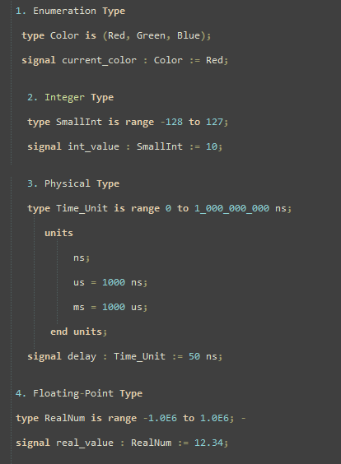
SCALAR TYPES
Scalar types are simple, non-divisible types including integers, floating-point numbers, physical types, and enumerations. For example:
Enumeration Type: Defines a set of named values, which is helpful for states in a state machine (e.g., type State is (IDLE, RUNNING, STOPPED);)
Integer Type: Represents whole numbers, useful for counters and indexes
Physical Type: Used to denote physical quantities with units (e.g., time)
Floating-Point Type: Useful for representing real numbers with fractional parts

Slide 13
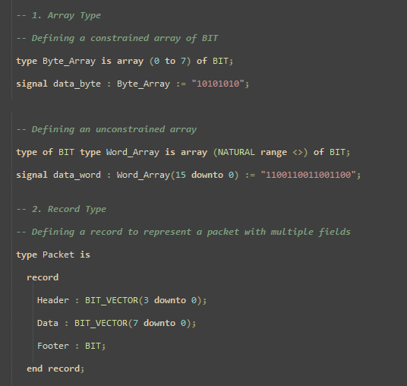
COMPOSITE TYPES
Composite types allow for grouping multiple elements, which can be arrays or records.
Array Types: Consist of elements of the same type and can be indexed (e.g., type Memory is array (0 to 31) of Bit;).
Record Types: Consist of elements of potentially different types, useful for grouping related data (e.g., defining a record type for a data packet with fields like Header and Payload).

Slide 14
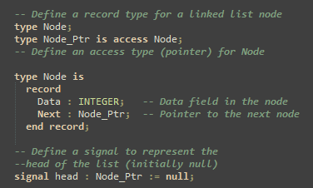
ACCESS TYPES
Access types provide pointers to objects, allowing dynamic memory management. For example, you can declare a pointer to an integer type with
type Int_Ptr is access Integer;
An access type has a default null value, indicating it does not reference any object. This is useful for initializing pointers before actual allocation.
Allocation creates a new object dynamically, and each access type supports a DEALLOCATE procedure to free the allocated memory, helping manage memory resources.

Slide 15
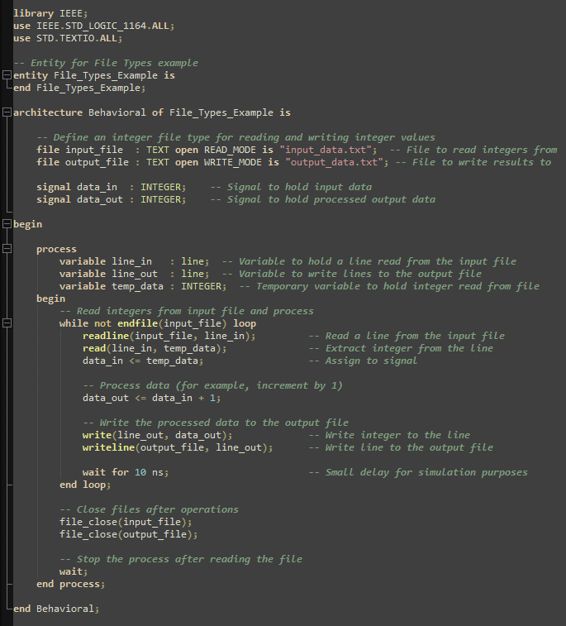
FILE TYPES
File types enable VHDL designs to interact with external data files, useful for test benches to read or write simulation data. File types are used to interact with external files in the host environment, with the following aspects:
1-File Type Definition: Defined with file of followed by a type mark, file types may store sequences of values of a designated type.
type Text_File is file of String;
2-File Operations: VHDL supports basic file operations such as FILE_OPEN, FILE_CLOSE, READ, and WRITE. These operations facilitate reading from and writing to files, with modes including READ_MODE, WRITE_MODE, and APPEND_MODE.
3- TextIO: The package TEXTIO includes types and procedures for formatted I/O on text files, making it easier to manage ASCII data within VHDL.

Slide 16
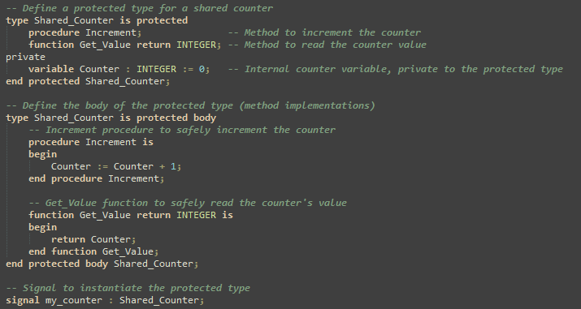
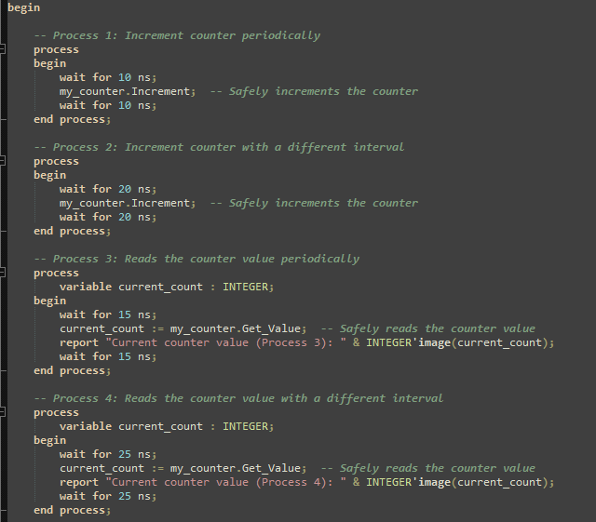
PROTECTED TYPES
Protected types are for concurrent access control, allowing multiple processes to access shared data safely. They support operations like reading, writing, and locking data.

Slide 17
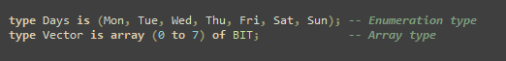
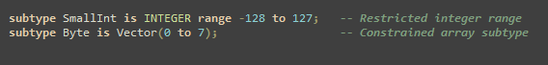
TYPE DECLARATIONS
Type declarations define new data types in VHDL, allowing custom structures and types for more precise data representation.
SUBTYPE DECLARATIONS
Subtypes create subsets of an existing type with constraints on values or range.

Slide 18
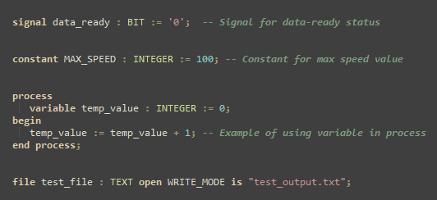
OBJECTS
Objects represent instances of types and are classified as signals, constants, variables, or files in VHDL.
Signal: Used to represent hardware connections and changes over time.
Constant: Holds a fixed value throughout simulation, useful for parameters.
Variable: Declared inside a process for temporary data storage.
File: Allows interaction with external text or binary files, often used for testbenches.

Slide 19
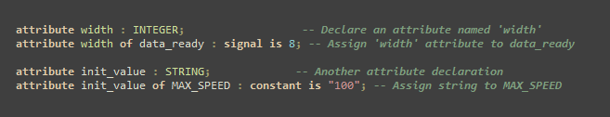
ATTRIBUTE DECLARATIONS
Attributes are user-defined properties attached to types, signals, entities, etc. They can store metadata or control simulation aspects.

Slide 20
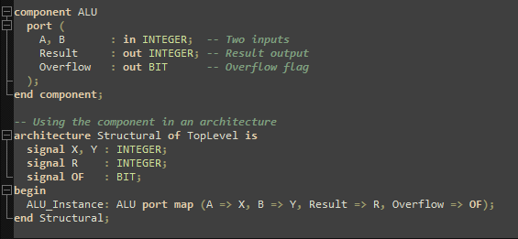
COMPONENT DECLARATIONS
Components act as templates for modules or logic blocks that can be instantiated multiple times in a design. This allows reusability and modular design.

Slide 21
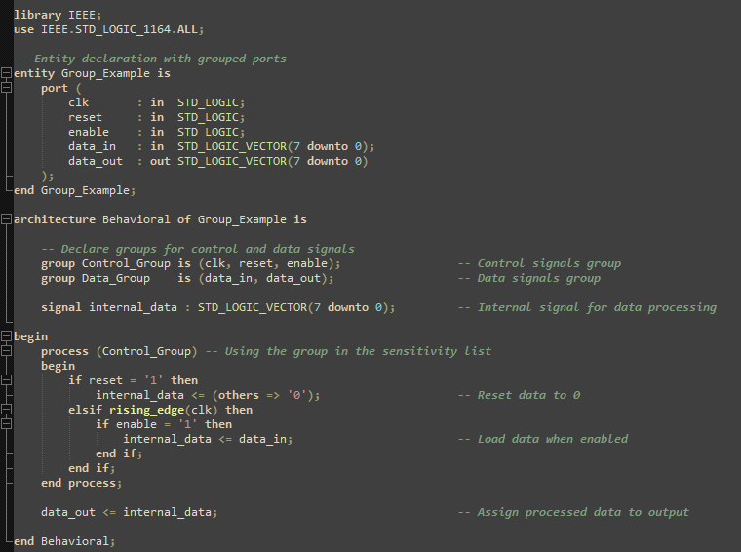
GROUP DECLARATIONS
Groups in VHDL are used to collect related signals or ports, especially helpful for organization or hierarchical designs.

Slide 22
5. SPECIFICATIONS
Chapter 5 and 6
Presenter:
Seyit Koçak
5.1 Attribute Specification
5.2 Configuration Specification
5.3 Disconnection Specification
6. NAMES
6.1 Names
6.2 Simple Names
6.3 Selected Names
6.4 Indexed Names
6.5 Slice Names
6.6 Attribute Names

Slide 23
5. SPECIFICATIONS
In VHDL, Specifications are used to define additional information associated with entity in a design. There are three main types of specifications:
Attribute Specifications, Configuration Specification, Disconnection Specification
5.1 Attribute Specification
Attributes are a feature of VHDL that allow you to extract additional information about an object
Attributes also allow you to assign additional information to objects in your design description
An attributes is a value, function, type, range, signal or a constant
The others keyword applies the attribute to unnamed entities in the specified class
The all keyword applies the attribute to all entities in the specified class

Slide 24
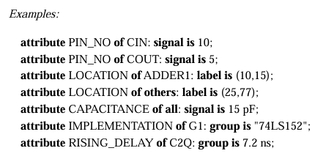
5.1 Attribute Specification
The PIN_NO attribute is assigned as 10 and 5 for the CIN and COUT signals, respectively.
The LOCATION attribute is set to (10,15) for ADDER1 and (25,77) for other components.
The CAPACITANCE attribute is assigned as 15 pF to all signals.
The IMPLEMENTATION attribute is applied to the G1 group with the value "74LS152".
The RISING_DELAY attribute is set to 7.2 ns for the C2Q group.

Slide 25
5.2 Configuration Specification
A VHDL configuration specification defines how instances of a specific component are connected and used in a design.
It associates component instances with binding information, determining the role of the component within the design structure.
5.2.1 Binding Indication: Defines the entity or configuration a component instance will link to in the design.
5.2.1.1 Entity Aspect: Identifies the specific entity a component instance is bound to, making the link explicit.
5.2.1.2 Generic Map and Port Map Aspects: Specifies values or signals for generics and ports using generic map and port map.
5.2.2 Default Binding Indication: Determines the entity or configuration used when no explicit binding is provided, following VHDL’s default rules.

Slide 26
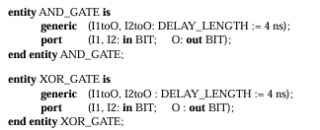
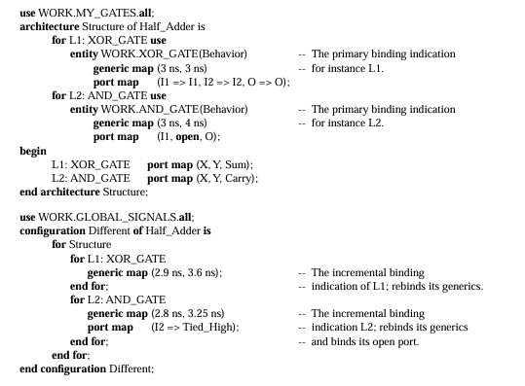
5.2 Configuration Specification
Binding Indication: The statements entity WORK.XOR_GATE(Behavior) and entity WORK.AND_GATE(Behavior) show the primary binding indications for the component instances L1 and L2
Entity Aspect: WORK.XOR_GATE(Behavior) and WORK.AND_GATE(Behavior) are used as entity aspects for L1 and L2
Generic Map and Port Map Aspects:
Statements like generic map (3 ns, 3 ns) and port map (I1 => I1, I2 => I2, O => O) define the generic and port map aspects for L1
Generic map (3 ns, 4 ns) and port map (I1, open, O) specify the generic and port map aspects for L2
Incremental Binding Indication: In configuration Different, incremental binding is applied to rebind generics for L1 and L2

Slide 27
5.3 Disconnection Specification
A disconnection specification defines the time delay after which the driver of a guarded signal will automatically disconnect. It controls how long a signal remains active before it is disconnected
.
SCALAR SIGNAL
For a simple, scalar signal, like SIGNAL_A, a disconnection specification might look like this:
-- disconnect SIGNAL_A: BIT after 10 ns;
This means SIGNAL_A remains active for 10 ns, then disconnects.
COMPOSITE SIGNAL
For a composite signal (e.g., BIT_VECTOR), each element can have its own disconnection time.
--disconnect SIGNAL_B: BIT_VECTOR(3 downto 0) after 15 ns;
Each bit of SIGNAL_B (SIGNAL_B(3), SIGNAL_B(2), SIGNAL_B(1), SIGNAL_B(0)) will disconnect after 15 ns.
The disconnection occurs in parallel for all bits; they all disconnect 15 ns after activation

Slide 28
6. NAMES
6.1,2 Simple Names
In code, names refer to various entities like objects, values, methods, attributes, or slices. Simple names directly identify an entity, while selected names indicate a sub-element.
Static names are fixed and evaluated at compile time, whereas dynamic names are evaluated at runtime and contain variable data.
A simple name is the identifier associated with an entity, function, procedure, or package during its declaration. This identifier is used to reference the entity throughout the code.
The evaluation of a simple name only serves to identify the entity it denotes; it has no other side effects or functionality.
entity LED_Controller is
--Content
end LED_Controller;
In this example, LED_CONTROLLER is the SIMPLE NAME for the entity.

Slide 29
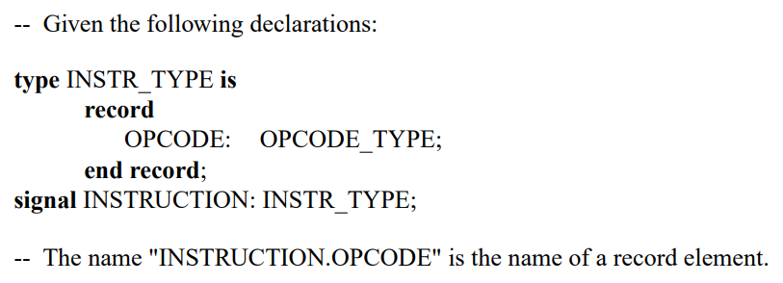
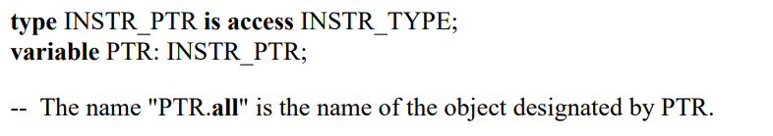
6.3 Selected Names
Selected names are used to refer to an entity that is declared within another entity or a design library
library IEEE;
use IEEE.STD_LOGIC_1164.ALL;
Here, IEEE.STD_LOGIC_1164 is a selected name. IEEE prefix, and STD_LOGIC_1164 is the suffix
Selected names can Access elements within a record type
In this case the prefix should be an object of the record type, and the suffix should specify an element of that record

Slide 30
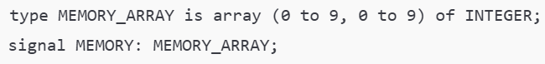
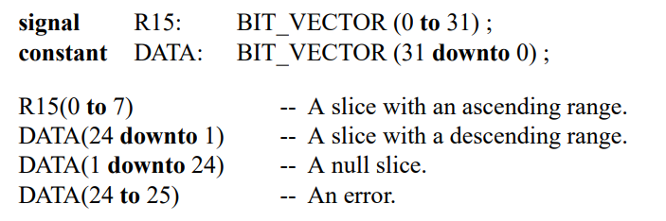
6.4 Indexed Names
In this example, a two- dimensional array names MEMORY is defined. The expression Memory(3,7) refers to the element at row 3, column 7 of the MEMORY array
Memory(3,7) is an indexed name
Memory is the prefix, and (3,7) are the corresponding index values
6.5 Slice Names
A slice has the same type as the array it belongs to (e.g., signal or constant).
The slice range must be within the array’s bounds and have the same direction; otherwise, an error occurs.

Slide 31
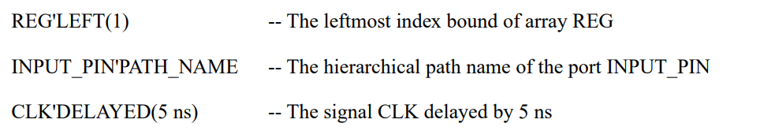
6.6 Attribute Names
Attribute names express a specific attribute (value, function, type, signal, etc.) of an entity and consist of a prefix and an attribute designator.
The prefix must be compatible with the attribute designator. For example, some attributes only apply to array or signal types.
Predefined attributes may require an additional expression. For user-defined attributes, the prefix cannot denote a subelement or a slice of an object.

Slide 32
Chapter 7
Presenter:
Koray Karakurt
7. Expressions
7.1 Expressions
7.2 Operators
7.3 Operands
7.4 Static Expressions
7.5 Universal Expressions

Slide 33
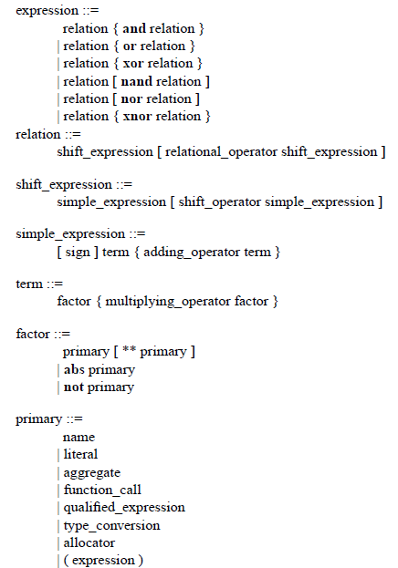
7.1 EXPRESSIONS
Expression: A formula defining the computation of a value
The type of an expression depends only upon
The types of its operands
On the operators applied
Primary: Has a value and a type
Notes:
Bir satır sonu her zaman bir ayırıcıdır.

Slide 34
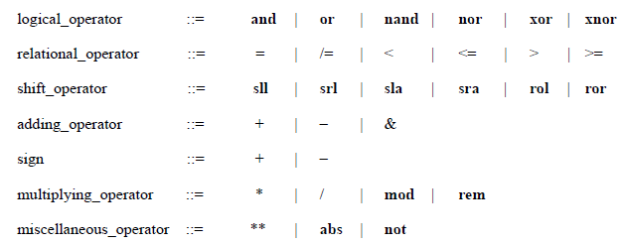
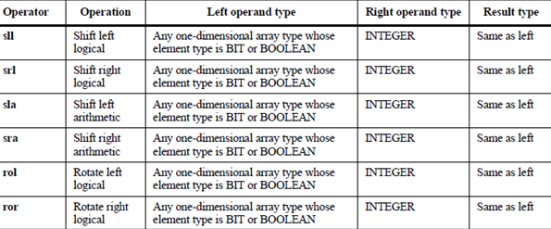
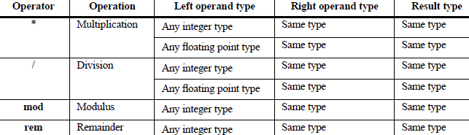
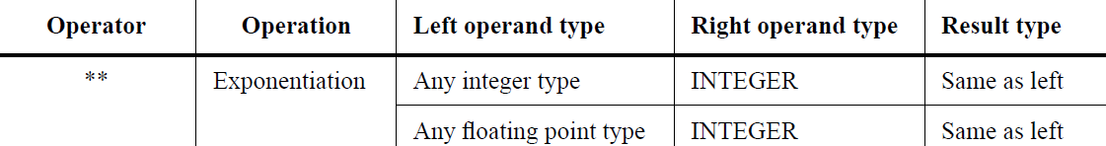
7.2 OPERATORS
The operators that may be used in expressions are defined below:
Each operator belongs to a class of operators, all of which have the same precedence level; the classes of operators are listed in order of increasing precedence
In general, operands in an expression are evaluated before being associated with operators
Notes:
Bir satır sonu her zaman bir ayırıcıdır.

Slide 35
7.3 OPERANDS
The operands in an expression include
Name (Names are defined in 6.1; the other kinds of operands are defined in 7.3.1 through 7.3.6.)
Literal: A numeric, an enumeration, a string, a bit string, or the literal null (7.3.1)
Aggregate: A basic operation combining one or more values into a composite value of a record or array type (7.3.2)
Function Call: A function call invokes the execution of a function body (7.3.3)
Qualified Expression: A basic operation used to explicitly state the type, and possibly the subtype, of an operand that is an expression or an aggregate (7.3.4)
Type Conversion: Provides for explicit conversion between closely related types (7.3.5)
Allocator: The evaluation of an allocator creates an object and yields an access value designating the object (7.3.6)
An expression enclosed in parentheses may be an operand in an expression
Notes:
Bir satır sonu her zaman bir ayırıcıdır.

Slide 36
7.4 STATIC EXPRESSIONS
Certain expressions are said to be static
Similarly, certain discrete ranges are said to be static, and the typemarks of certain subtypes are said to denote static subtypes
There are two categories of static expression:
Certain forms of expression can be evaluated during the analysis of the design unit in which they appear; such an expression is said to be locally static
Certain forms of expression can be evaluated as soon as the design hierarchy in which they appear is elaborated; such an expression is said to be globally static
Notes:
Bir satır sonu her zaman bir ayırıcıdır.

Slide 37
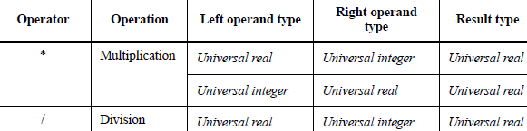
7.5 UNIVERSAL EXPRESSIONS
A universal_expression is either an expression that delivers a result of type universal_integer or one that delivers a result of type universal_real
The same operations are predefined for the type universal_integer as for any integer type
The same operations are predefined for the type universal_real as for any floating point type
In addition, these operations include the following multiplication and division operators:
The accuracy of the evaluation of a universal expression of type universal_real is at least as good as the accuracy of evaluation of expressions of the most precise predefined floating point type supported by the implementation, apart from universal_real itself
Notes:
Bir satır sonu her zaman bir ayırıcıdır.

Slide 38
Chapter 8
Presenter:
Orhan Çalışkan
8. Sequential statements
8.1 Wait Statement
8.2 Assertion Statement
8.3 Report Statement
8.4 Signal Assignment Statement
8.5 Variable Assignment Statement
8.6 Procedure Call Statement
8.7 If Statement
8.8 Case Statement
8.9 Loop Statement
8.10 Next Statement
8.11 Exit Statement
8.12 Return Statement
8.13 Null Statement

Slide 39
CHAPTER - 8
SEQUENTIAL STATEMENTS
Wait_Statement: Pauses Execution Process / Procedure Until a Condition is Met
Assertion_Statement: Checks Whether a Condition Holds True
Report_Statement: Outputs or Reports a Message
Signal_Assignment_Statement: Assigns a Value to a Signal
Variable_Assignment_Statement: Assigns a Value to a Variable
Procedure_Call_Statement: Calls a Procedure
If_Statement: Directs Flow Based on Conditions
Case_Statement: Selects and Executes an Option Based on a Value
Loop_Statement: Repeats Statements Based on a Condition
Next_Statement: Skips the Current State Moves to Next
Exit_Statement: Exits the Loop
Return_Statement: Return Value From Function
Null_Statement: No Operation Statement

Slide 40
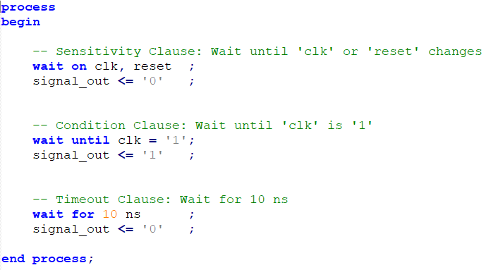
WAIT STATEMENT
[ label : ] wait [ sensitivity_clause ] [ condition_clause ] [ timeout_clause ]
No Condition = Default Until True = Endless Wait
Wait Statement Generally Use Testbenchs

Slide 41
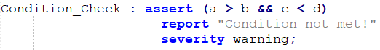
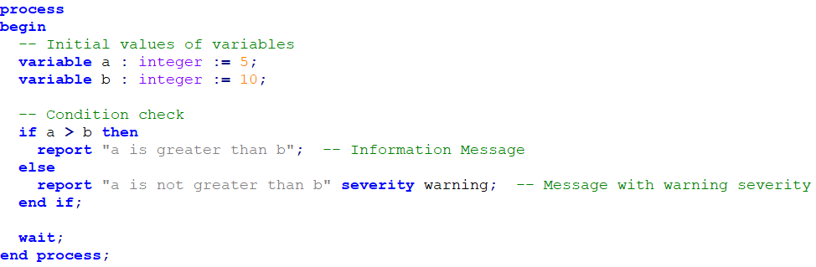
ASSERTION STATEMENT
[ label : ] Assert Condition
[report expression]
[severity expression] !! None Report = Default Assertion Violation
!! None Severity = Default Error
[ label : ] report expression [ severity expression ];
REPORT STATEMENT

Slide 42
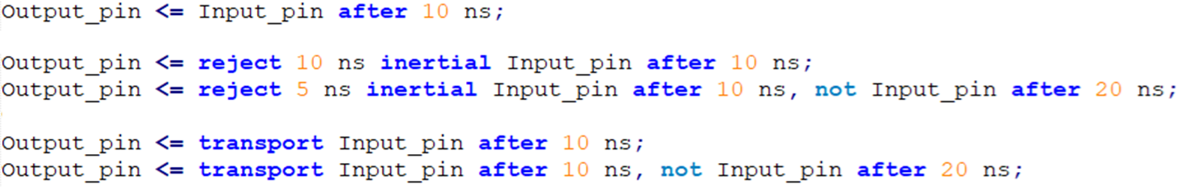
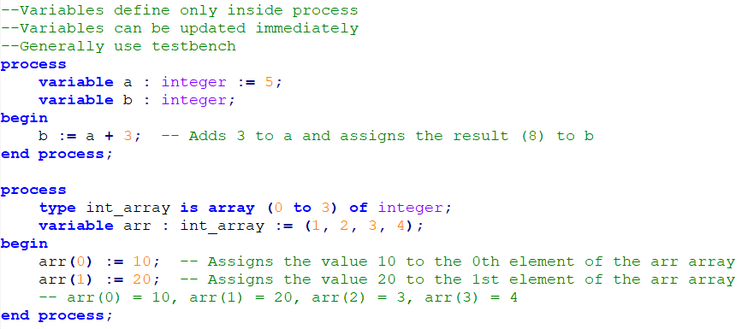
SIGNAL ASSIGNMENT STATEMENT
signal_name <= expression [ after time ] [ delay_mechanism ];
VARIABLE ASSIGNMENT STATEMENT

Slide 43
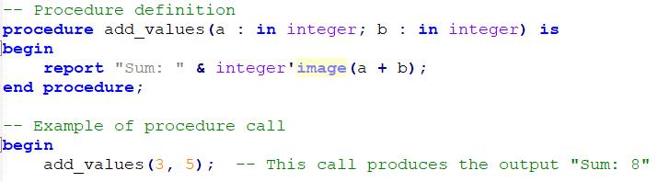
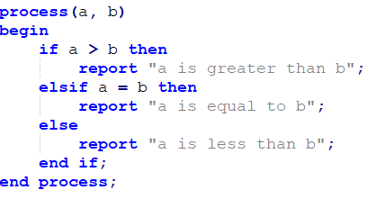
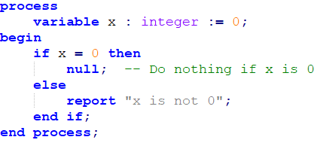
PROCEDURE CALL STATEMENT
IF STATEMENT
NULL STATEMENT

Slide 44
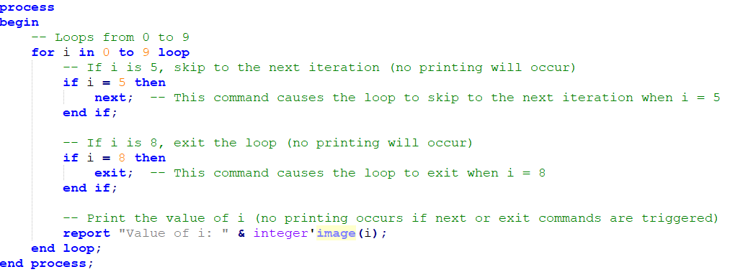
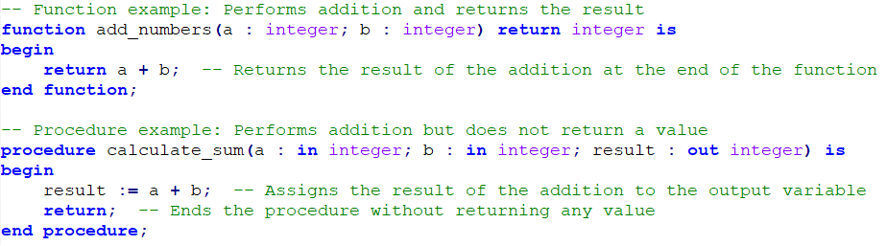
NEXT AND EXIT STATEMENT
RETURN STATEMENT

Slide 45
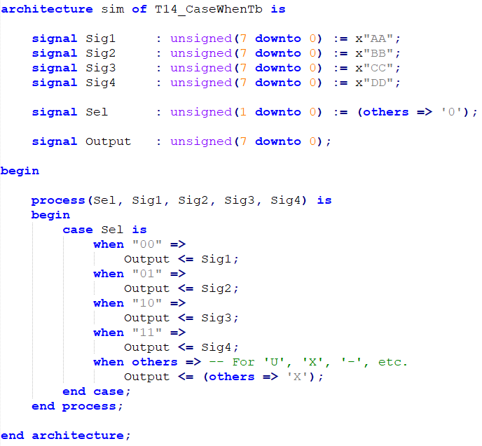
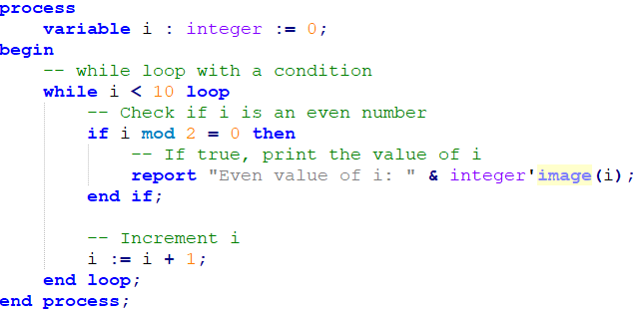
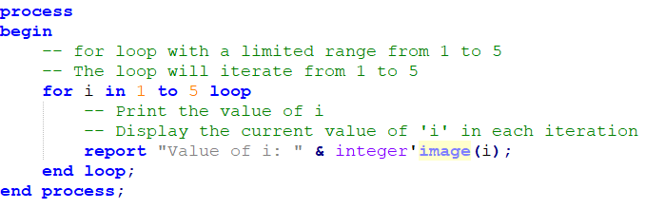
CASE STATEMENT
LOOP STATEMENT

Slide 46
Chapter 9 and 10
Presenter:
Talha Telli
9. Concurrent statements
9.1 Block Statement
9.2 Process Statement
9.3 Concurrent Procedure Call Statements
9.4 Concurrent Assertion Statements
9.5 Concurrent Signal Assignment Statements
9.6 Component Instantiation Statement
9.7 Generate Statements
10. Scope and visibility
10.1 Declarative Region
10.2 Scope of Declarations
10.3 Visibility
10.4 Use Clauses
10.5 The Context of Overload Resolution

Slide 47
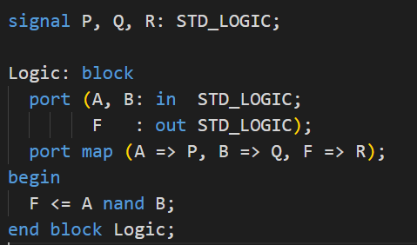
BLOCK STATEMENT
Defines an internal block representing a portion of a design
Blocks can be hierarchically nested within each other to support design decomposition
The block statement manages design complexity by supporting local signals, modular design, and hierarchy
Labeling and local declarations enable a more organized and readable code structure
From: VHDL Golden Reference Guide - Sample Code Fragments

Slide 48
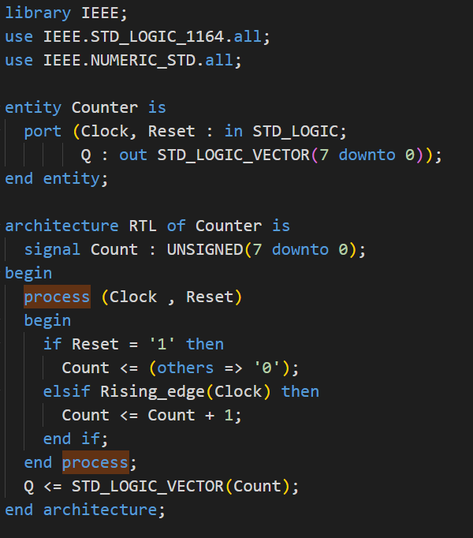
PROCESS STATEMENT
Defines an independent sequential process representing the behavior of some portion of the design
The sensitivity list specifies which signals' changes will cause the process to be triggered. When a process has a sensitivity list, it only triggers when one of the signals in that list changes
Active Processes
Include Signal Assignments
Triggered by Changes in their sensitivity list
Passive processes
Have no signal assignments
Execute internal logic
From: VHDL Golden Reference Guide - Sample Code Fragments

Slide 49
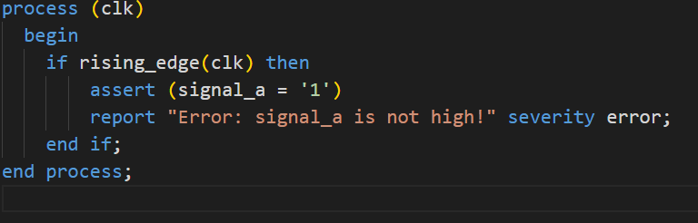
Concurrent assertion statement
A concurrent assertion statement is a construct that passively checks validation conditions and sends error messages to the simulation report
Concurrent assertion statements do not cause events to occur during simulation, but they provide a mechanism for reporting errors when assertions fail
From: VHDL Golden Reference Guide - Sample Code Fragments

Slide 50
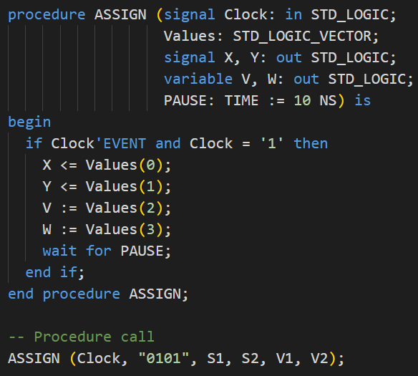
Concurrent procedure call statements
Represents a process containing the corresponding sequential procedure call statement
A concurrent procedure call in architecture executes at the same hierarchical level as other concurrent statements, facilitating modular signal updates and enabling parallel operation within the concurrent domain
From: VHDL Golden Reference Guide - Sample Code Fragments

Slide 51


Concurrent signal assignment statements
Represents an equivalent process statement that assigns values to signals
Execution of a concurrent signal assignment statement is equivalent to execution of the equivalent process statement
There are two forms of the concurrent signal assignment statement
Conditional Signal Assignments
Selected Signal Assignments
From: VHDL Golden Reference Guide - Sample Code Fragments

Slide 52

Component instantiation statements
It is a mechanism that allows for the iterative or conditional elaboration of a specific portion of a design. This is used for the creation of repetitive components or conditional structures
Instantiation of a component can be expressed in two ways
Instantiation of a component
Instantiation of a design entity
From: VHDL Golden Reference Guide - Sample Code Fragments

Slide 53


Generate Statement
Defines a subcomponent of the design entity in which it appears
Associates signals or values with the ports of that subcomponent, and values with generics of that subcomponent
The generate statement is used in two ways
For Generate
If Generate
From: VHDL Golden Reference Guide - Sample Code Fragments

Slide 54
DECLERATIVE REGION
A declarative region in VHDL is a defined area where specific declarations are valid
Declarative regions are established by constructs like entity, architecture, process, block, package, component, and configuration, each forming its own scope
Each primary unit has a root declarative region, and each design library includes a region covering all its units
SCOPE of DECLERATIONS
A declaration’s scope begins where it is declared and extends to the end of its nearest declarative region, defining where it can be used.=
The immediate scope covers the area from the start of the declaration to the end of its nearest declarative region
Certain declarations, like those in package, record, subprogram parameters, or components (generic and port), can extend beyond their immediate scope, applying throughout their entire enclosing region or library

Slide 55
VISIBILITY
Visibility rules define which identifier is accessible within a certain area, and overloaded names are clarified by additional rules
Visibility can be achieved by selection (using use clauses) or directly, where identifiers are accessible in their immediate area unless hidden by another declaration with the same name
If two declarations share the same name in overlapping areas, the outer one is hidden in the inner area, except for predefined operations, which are always hidden by explicit declarations
USE CLAUSE
A use clause makes certain declarations directly accessible in the code without needing further references
The visibility of a use clause starts right after it is written and continues to the end of its surrounding region, such as a design unit or configuration
If there’s another declaration with the same name in a closer scope, the use clause declaration isn’t accessible, except for unique functions or enumeration items

Slide 56
The context of overload resolution
Overload resolution defines the exact meaning of an identifier or operator when multiple meanings are possible, ensuring a single valid interpretation within a specific context
Overload resolution considers only syntax, scope, visibility, and specific type rules, such as matching types, required type classes, and appropriate prefixes
An occurrence is only legal if there is a unique valid interpretation for each part of the context, while additional checks like parameter modes and conformance may still apply for full validity

Slide 57
11. Design units and their analysis
Chapter 11 and 12
Presenter
Furkan Kaya
11.1 Design units
11.2 Design libraries
11.3 Context clauses
11.4 Order of analysis
12. Elaboration and execution
12.1 Elaboration of a design hierarchy
12.2 Elaboration of a block header
12.3 Elaboration of a declarative part
12.4 Elaboration of a statement part
12.5 Dynamic elaboration
12.6 Execution of a model

Slide 58
11.1 DesIgn unıts
Definition of Design Units:
Purpose: individual components in VHDL can be independently define, analyze and store
Types: Key design units include:
Entity: External interface (inputs/outputs) of a component
Architecture Bodies: Specify the internal operation or structure of an entity
Configurations: Bind entities to architectures, defining how components are connected
Packages: Provide reusable resources like constants, types, and functions
Modularity: Supports independent analysis, testing, and REUSE in projects

Slide 59

11.2 DesIgn lIbrarIes
Definition of Design Libraries:
Purpose: Libraries organize and store design units, allowing them to be easily accessed and reused
Working Library: Holds units currently being developed or analyzed
Resource Libraries: Contain previously analyzed and reusable components, like IEEE for standard logic operations
This makes standard logic types and operations available

Slide 60

11.3 Context clauses
Definition of Context Clause:
Purpose: Context clauses define the environment for a design unit
Library Clause: Declares libraries accessible to the unit
Use Clause: Specifies which parts of a library are available, simplifying access
Provides direct access to arithmetic functions, avoiding full path references

Slide 61
11.4 Order of analysıs
Definition of Order of Analysis:
Dependency Management: Ensures units are analyzed in order, with primary units (like entities) processed before dependent units (like architectures)
Error Handling: Errors in primary units halt analysis of dependent units
Reanalysis: If a primary unit changes, dependent units must be reanalyzed
Incremental Compilation: Allows efficient reanalysis of only modified units and their dependencies

Slide 62



12.1 Elaboration of a design hierarchy
Definition of Elaboration of a design hierarchy:
Purpose: Sets up the hierarchy by creating instances and connections based on the design’s structure
Process: Starts with the top-level entity, then elaborates each nested component or subcomponent
Component Binding: Binds components to specific architectures or configurations, defining the full hierarchy

Slide 63

12.2 Elaboration of a block header
Definition of Elaboration of a block header:
Purpose: Sets up the interface for each design block, including generics and ports
Generics: Assigns values to parameters that control block behavior, like bit widths or timing
Ports: Connects inputs and outputs to external signals or expressions

Slide 64

12.3 Elaboration of a declarative part
Definition of Elaboration of a declarative part:
Purpose: Prepares internal elements like signals, constants, and variables in each block
Declarations: Initializes constants, allocates memory for variables, and sets up signals

Slide 65

12.4 Elaboration of a statement part
Definition of Elaboration of a statement part:
Purpose: Prepares executable statements for simulation, including both concurrent and sequential statements
Concurrent Statements: Includes signal assignments and processes that run simultaneously
Sequential Statements: Ordered operations within processes or subprograms

Slide 66

12.5 Dynamic elaboration
Definition of Dynamic elaboration:
Purpose: Manages runtime scenarios like deferred binding or conditional elaboration
Deferred Binding: Allows components to be bound conditionally, adapting to runtime states
From: https://www.vhdl-online.de/vhdl_reference_93/dynamic_elaboration

Slide 67
12.6 Execution of a model
Definition of Execution of a model:
Purpose: Simulates the design by executing concurrent and sequential statements over time

Slide 68
Chapter 13
Presenter:
Orhan Çalışkan
13. Lexical elements
13.1 Character Set
13.2 Lexical Elements, Separators, and Delimiters
13.3 Identifiers
13.4 Abstract Literals
13.5 Character Literals
13.6 String Literals
13.7 Bit String Literals
13.8 Comments
13.9 Reserved Words
13.10 Allowable Replacements of Characters

Slide 69


CHAPTER - 13
LEXICAL ELEMENTS
VHDL CHARACTER SET
VHDL divides two main groups: graphic characters and format effectors
Graphic Characters: Readability for users and compilers
Format Effectors: For visual layout (line breaks, tabs, and new lines)
LEXICAL ELEMENTS (SEPERATORS)
Separates lexical elements
A separator is either a space character(SPACE or NBSP), a format effector, or the end of a line

Slide 70



LEXICAL ELEMENTS (DELIMITERS)
Delimiter characters separate different elements in the syntax of the language
The delimiters in VHDL are generally specific characters, and each one performs a specific function
Notes:
Bir satır sonu her zaman bir ayırıcıdır.

Slide 71

LEXICAL ELEMENTS (IDENTIFIERS)
Basic identifiers
Define signals, ports, and variables
Can Contain Letters, Digits, Underscores
Extended identifiers
Define signals, ports, and variables
Case Sensitive
Enclosed in Backslashes (\)
Enable the Inclusion of Special Characters
Notes:
Bir satır sonu her zaman bir ayırıcıdır.

Slide 72

LEXICAL ELEMENTS (LITERALS)
Abstract Literals: Represent values in basic numerical types.
Decimal Literals: Express numerical values (integer or fractional)
Based Literals: Specify numerical values in a specific base (binary, octal, hexadecimal).
Bit String Literals: Define numerical systems with specific bit sequences (B, O, X)
Character Literals: Represent a single character
String Literals: Represent a sequence of characters
Notes:
Bir satır sonu her zaman bir ayırıcıdır.

Slide 73
Chapter 14
Presenter:
Koray Karakurt
14. Predefined language environment
14.1 Predefined Attributes
14.2 Package STANDARD
14.3 Package TEXTIO

Slide 74

14.1 VHDL PREDEFINED ATTRIBUTES
https://www.hdlworks.com/hdl_corner/vhdl_ref/VHDLContents/AttributesPredefined.htm
Notes:
Bir satır sonu her zaman bir ayırıcıdır.

Slide 75

14.2 package standard
Package STANDARD predefines a number of types, subtypes, and functions
An implicit context clause naming this package is assumed to exist at the beginning of each design unit
Package STANDARD cannot be modified by the user
The operators that are predefined for the types declared for package STANDARD are given in comments since they are implicitly declared
https://www.hdlworks.com/hdl_corner/vhdl_ref/VHDLContents/StandardPackage.htm
Notes:
Bir satır sonu her zaman bir ayırıcıdır.

Slide 76

14.3 Package TEXTIO
https://www.hdlworks.com/hdl_corner/vhdl_ref/VHDLContents/TEXTIOPackage.htm
Notes:
Bir satır sonu her zaman bir ayırıcıdır.

Slide 77
End of IEEE 1076 – 2002 Standard
VHDL Project Closure Presentation
THANKS
Furkan Kaya, Mert Ecevit, Orhan Çalışkan, Seyit Koçak and Talha Telli
www.youtube.com/@falsepaths

